Slide 1
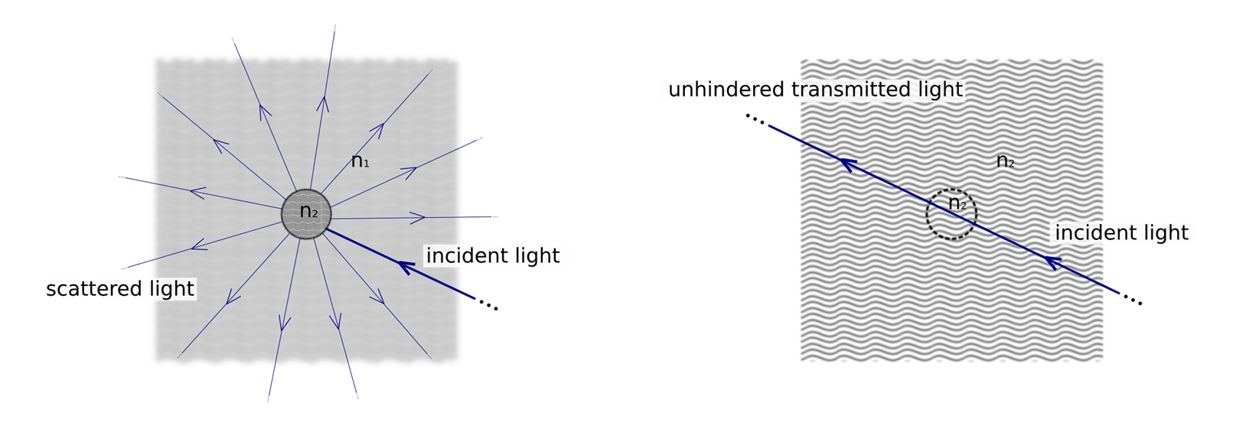
Tissue clearing
When a sample is surrounded by a medium with a different refractive index, light suffers multiple events scattering, therefore it appears opaque
If instead the sample and the surrounding medium share the same refractive index, no scattering occurs and light traverses the specimen unhindered. This causes the sample to appear transparent
Biological tissues are characterize from the presence of macro-molecules like proteins and lipid bilayers with different refractive index that make the clearing more difficult

Slide 2
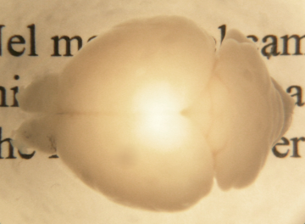
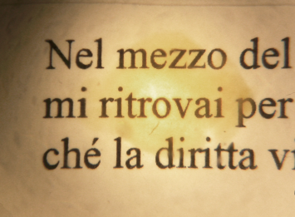
Tissue clearing
There are two different approaches to clear the brain:
Replace the water inside the tissue with a solvent (organic or aqueous) with the same proteins’ refractive index (chemical clearing)
Transform the brain into a nanoporous hydrogel-protein-hybridized lipid free form that is optically transparent and macromolecule-permeable (CLARITY)
Uncleared
Cleared

Slide 3
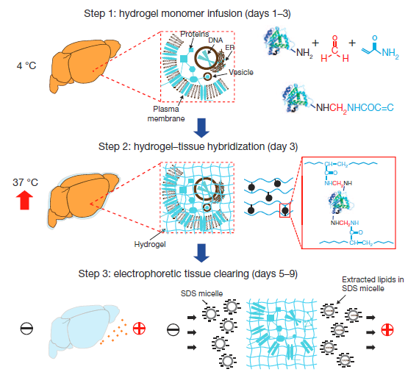
CLARITY
Step 1: formaldehyde crosslinks the tissue and the hydrogel monomers to proteins
Step 2: polymerization of the biomoleculeconjugated monomers into a hydrogel mesh
Step 3: extraction of the lipids with ETC
Step 4: refractive-index matching and imaging: usually FocusClear is used, which is a aqueous solvent extremely expensive (20$/ml). Each experiment might cost up to 2000 $
[Chung et al. Nature 2013]

Slide 4
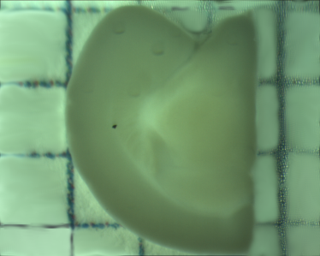
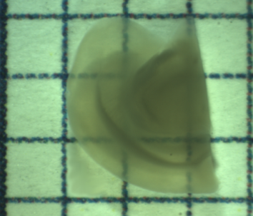
Optical clearing
Biological tissues are opaque because of light scattering, the refractive index of proteins is very different from that of water
To clear the tissues is necessary to replace the water inside the brain with a solvent (organic or aqueous) with the same proteins’ refractive index
Organic solvent (RI=1.56)
Aqueous solvent (RI=1.42)
Uncleared brain
THF + DBE
Uncleared slide 1mm
TDE
THF= tetrahydrofuran; DBE= dibenzyl ether; TDE= thiodiethanol

Slide 5
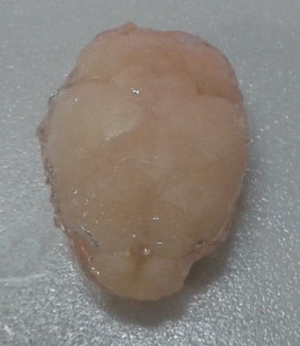
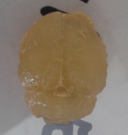
CLARITY
CLARITY is a method for the transformation of intact tissue into a nanoporous hydrogel-hybridized lipid free form that is fully assembled but optically transparent and macromolecule-permeable
[Chung et al. Nature 2013]

Slide 6
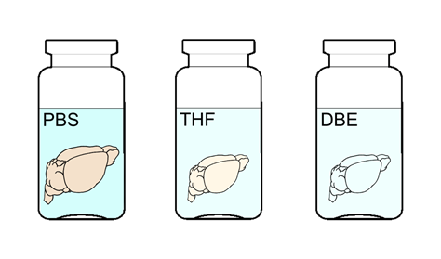

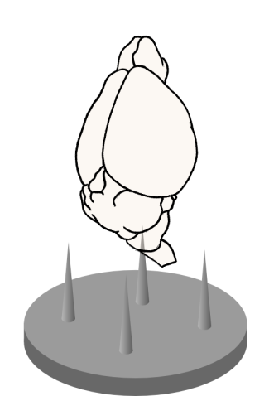
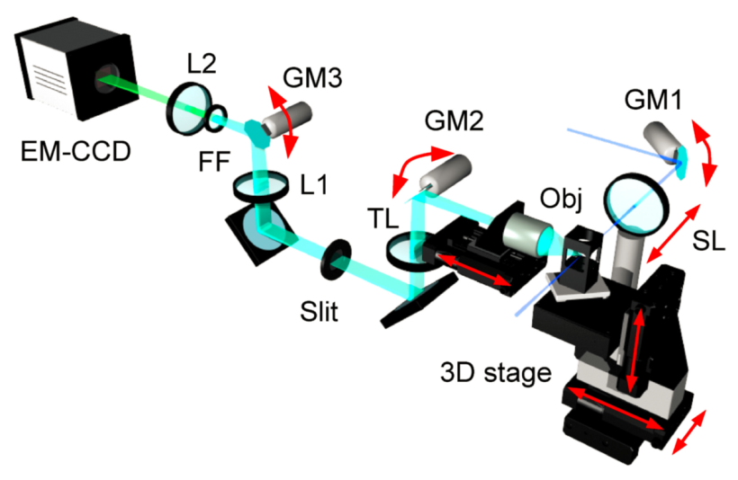
Connectomics protocol
Transgenic animals
GFPM
Preparation
Dehydration
Clearing
Mounting
Tomography and image analysis

